Slide 1
Department of Artificial Intelligence and Machine Learning
PBL Presentation
Title: QUARANTINE WRISTBAND
Presented By
Miss Puja S USN: 1BY19AI040
Mr. Pulturu Yaswanth USN: 1BY19AI041
Mr. Rahul Srivastava USN: 1BY19AI042
Mr. Dhananjay Kumar Singh USN: 1BY19CV008
Under the guidance of:
Dr. Anupama H S
Associate Professor , AI & ML
BMSIT&M
2020-21
ODD Semester

Slide 2
Content
Abstract
Introduction
Literature Survey
Motivation
Existing System
Limitations of Existing System
Proposed System
System Requirement Specifications
Proposed Methodology
Algorithm
Implementation
Conclusion
Future enhancement
References

Slide 3
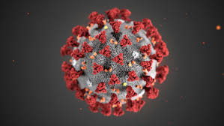
Abstract
COVID 19
Mild to severe respiratory illness caused by SARS COV-2
Symptoms
Fever
Dry cough
tiredness
Prevention
Sanitize
Social distancing
Mask

Slide 4
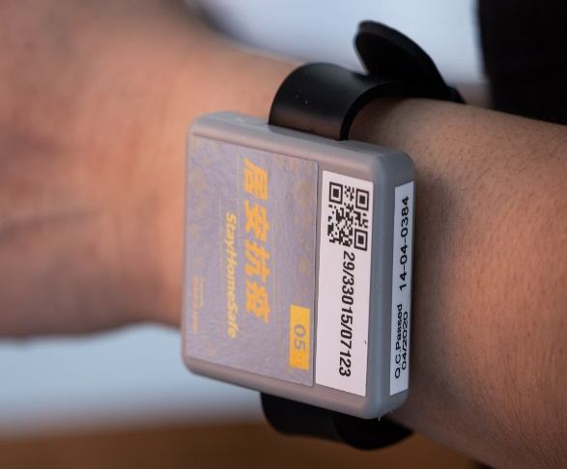
Introduction
Basic features:
Locked and activated once worn
Cannot be Tampered
Measures Temperature, Heart rate and SPO2 levels

Slide 5
Literature Survey
EAI Endorsed Transactions
How to Electronics
News India Express
Electronics Forum
SVS Embedded

Slide 6
Motivation
Budget friendly
Detect absconding patients in real time
Prevent the spread

Slide 7
Existing System
Hong Kong Govt. designed a wristband for its overseas Travellers.
Abu Dhabi IT Manager designed a wristband “My Quarantine”.
South Korea developed an Electric Wristband for those who defy quarantine orders.
Mysuru students designed wristband “Goaway bands”

Slide 8
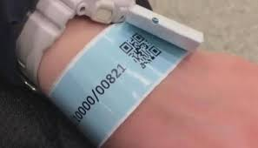
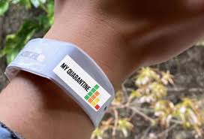
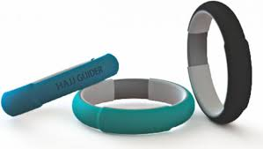
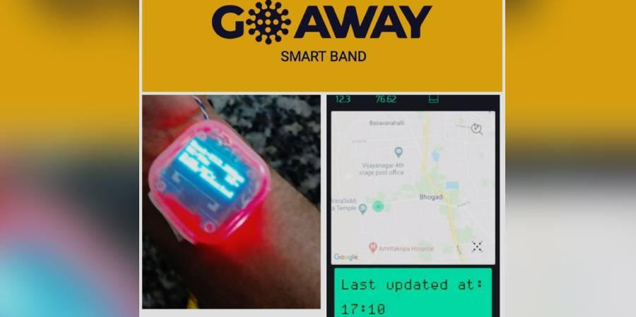

Slide 9
Limitations
Easily tampered
Delay in registration
Low efficiency

Slide 10
Proposed System
Tampering detection cable
High efficiency sensors
Good battery life

Slide 11
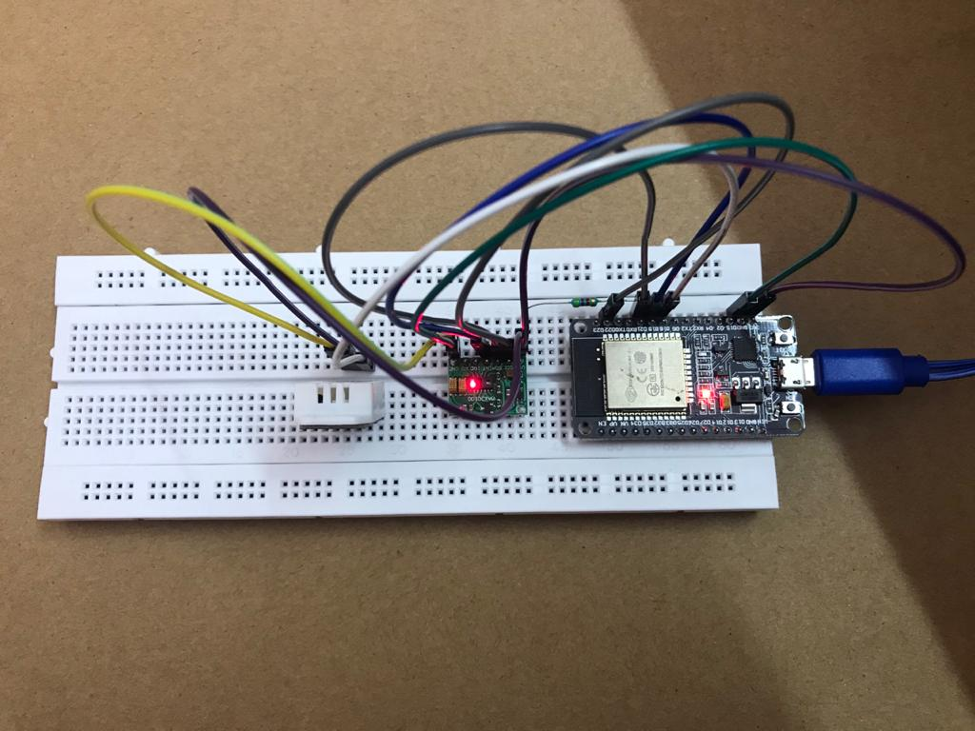
System Requirements
Functional:
ESP32
Tampering detection cable
MAX30100
DHT22
Battery
USB cable

Slide 12
System Requirements
Non-functional:
Budget friendly
Highly secured
Accurate
Real time detection
Historical data
Waterproof

Slide 13
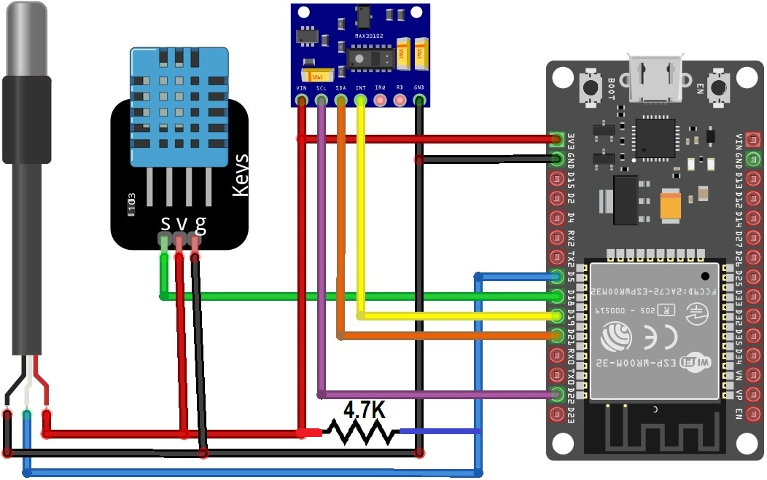
Proposed Methodology
Circuit connection:

Slide 14
Algorithm
Step1: Input SSID and wi-fi password
Step2:Print wi-fi connected
Step3:Set up the HTTP server
Step4:Print Initializing pulse oximeter
Step5:if (!pox.begin())
{
Serial.println("FAILED");
for (;;);
}
else

Slide 15
{
Serial.println("SUCCESS");
pox.setOnBeatDetectedCallback(onBeatDetected);
}
Step6:Register a callback for beat detection
Step7:if (millis() - tsLastReport > REPORTING_PERIOD_MS)
{
Serial.print("Room Temperature: ");
Serial.print(DHT.temperature);
Serial.println("°C");
Serial.print("Room Humidity: ");
Serial.print(DHT.humidity);

Slide 16
{
Serial.println("%");
Serial.print("BPM: ");
Serial.println(BPM);
Serial.print("SpO2: ");
Serial.print(SpO2);
Serial.println("%");
Serial.print("Body Temperature: ");
Serial.print(bodytemperature);
Serial.println("°C");
{ Serial.println("******************************");
Serial.println();
tsLastReport = millis();}}

Slide 17
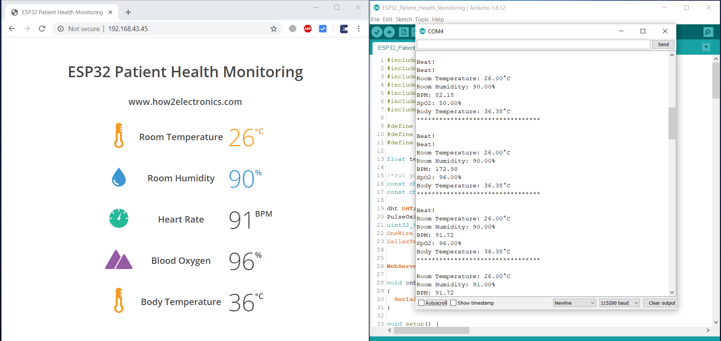
Implementation

Slide 18
Conclusion
Minimalist Design
Budget friendly
Global supply chain disruption
Low cost

Slide 19
Future Enhancement
Predict the probability of a person to abscond.
3D printed wristband

Slide 20
Reference
https://eudl.eu/pdf/10.4108/eai.13-7-2018.163997
https://www.youtube.com/watch?v=6nR1b5bhwg0
https://www.electronicsforu.com/electronics-projects/prototypes/coronasecure-covid-19-heath-band
https://www.newindianexpress.com/states/karnataka/2020/apr/02/goaway-bands---a-smart-band-to-the-people-under-quarantine-2124767.html
https://how2electronics.com/iot-based-patient-health-monitoring-esp32-web-server/

Slide 21
Thank you

